Slide 1
CS 4350: Fundamentals of Software Engineering CS 5500: Foundations of Software Engineering Lesson 2.3 Design Patterns
Jon Bell, John Boyland, Mitch Wand
Khoury College of Computer Sciences
© 2021 Jonathan Bell, John Boyland and Mitch Wand. Released under the CC BY-SA license

Slide 2
Outline of Lessons 2.3 and 2.4
Introduction to patterns:
what are they?
what are they good for?
Review of patterns you probably know
Adapter
Composite
Iterator
Some patterns you may or may not know
Singleton
Observer (sometimes called Listener, or Publish/Subscribe)
Visitor

Slide 3
Learning Objectives for this Lesson
By the end of this lesson you should be able to:
Define what a design pattern is and the role it plays in the Software Development process
Explain and illustrate the following patterns
Adapter
Composite
Iterator

Slide 4
What is a design pattern?
Think of it as advice from a master to a novice.
A master chef may advise a novice on knife technique
A golf pro may advise a novice about their swing
A piano teacher may advise a student about their posture, or how to interpret a piece
Often these pieces of advice are stylized and recorded
eg "keep your elbow straight" (golf) "use the tip of your knife as a fulcrum" (knife technique)
Maybe in a book of "technique"
Maybe on YouTube
etc.

Slide 5
What is in such a piece of advice?
A problem to be solved
"the golf ball keeps flying off to the side"
"it's taking too long to chop the carrots"
A technique or method for solving the problem
The technique always needs to be adapted to the problem at hand
is the golf ball lying on a slope? what kind of slope?
do you have a proper chopping board? what kind of knife are you using?

Slide 6
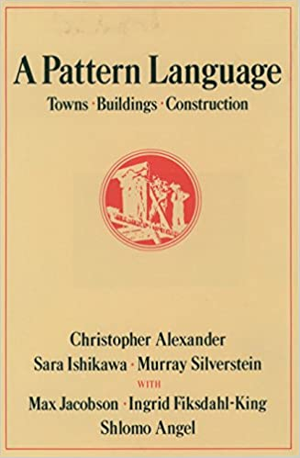
Design Patterns in Architecture
"A Pattern Language: Towns, Buildings, Contruction" by Christopher Alexander (1977)
introduced this idea to a wide community beyond architects

Slide 7
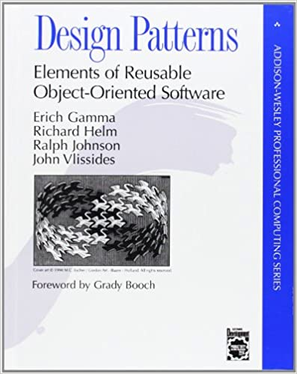
Gang of Four Book
First (and only!) edition 1994
Introduced this idea to object-oriented design
Started the "Software Patterns" movement
Still #1 on Amazon in Object-Oriented Software Design

Slide 8
Definition
Alexander says:
"Each pattern describes a problem which occurs over and over again in our environment, and then describes the core of the solution to that problem, in such a way that you can use this solution a million times over, without ever doing it the same way twice"

Slide 9
Elements of a Pattern
the pattern name
the problem (when to apply the pattern)
the solution (describes the elements that make up the pattern)
the consequences (the results and trade-offs of applying the pattern)
This is the official definition, taken from the GoF book.
Alas, when they get around to describing patterns, their descriptions rarely match this outline ☹

Slide 10
Design Patterns are Controversial
For the last 25 years, software experts have lined up either as pattern fans or pattern skeptics
Sometimes there are endless debates about whether a given piece of code is or is not an instance of a particular pattern.
We are just not going to get into that.
Take a chill pill!
But keep your 5004/5010 notes close at hand.
These patterns are tools in your toolbox.

Slide 11
Design Patterns are Everywhere
Everytime you read a blog post or web page with some code illustrations, you are using a design pattern:
a piece of code to solve a particular problem
and which needs to be adapted to your particular situation.
But some patterns are classics that have names that you should be familiar with.

Slide 12
Problem #1:
Suppose we need to implement a stack, which has the following interface:
But we have a class List that implements IList:
// the usual stack operations
interface IStack<T> {
push(t: T) : void
pop() : T
size() : number
}
Of course, in Typescript you'd never do this, because in Typescript we almost always use arrays to represent lists.
interface IList<T> {
// add to end of list
add(t:T): void
// remove last element of the list
remove() : T
// returns the number of elements in the list
size() : number
}

Slide 13
Solution: an Adapter
class Stack<T> implements IStack<T> {
// top of stack is at end of list
constructor (private payload: IList<T>) {}
public push(t: T): void {
this.payload.add(t);
}
public pop(): T {
return this.payload.remove();
}
public size(): number {
return this.payload.size()
}
}
Important: if you do something like this, be sure to explain how the list should be interpreted as a stack. (Remember Design Principle 2!)

Slide 14
Problem #2:
You need to represent data that is tree-like
Example:
shapes, from Week 1.
A Shape is either
a square
a circle
or a compound of two shapes: a front shape and a back shape.

Slide 15
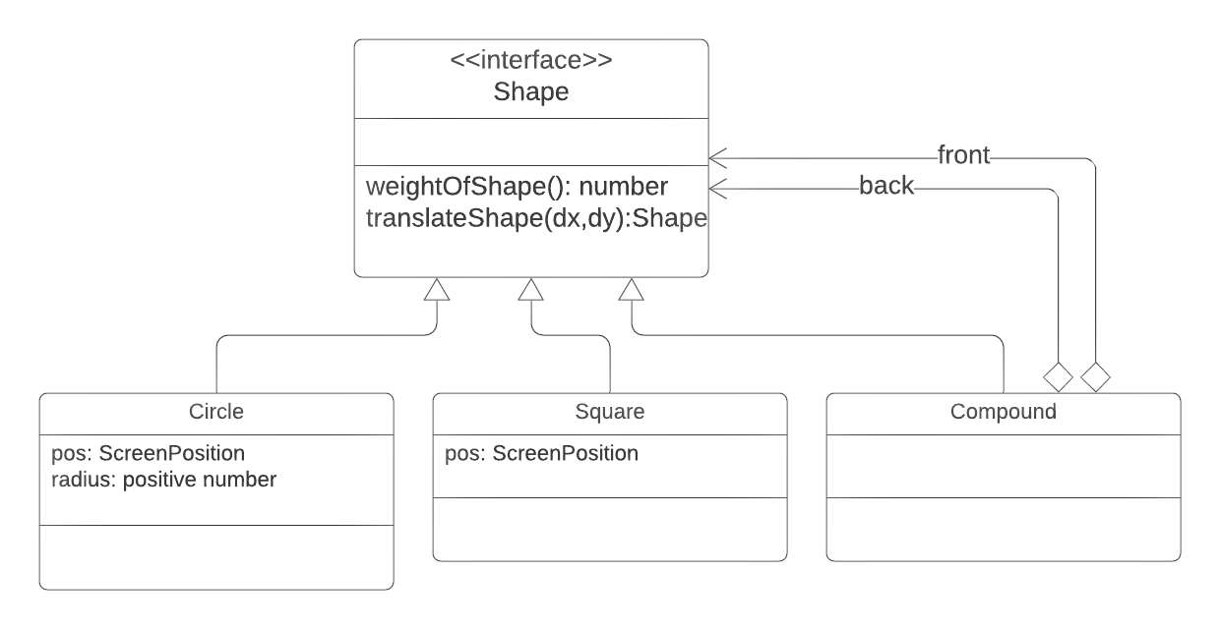
Solution: the Composite Pattern
We explained this example in Week 1. Now we've just added a name for what you already know.
Notice the circular dependency between Shape and Compound. That comes along with hierarchical (tree-like) data. There's no avoiding it.

Slide 16
Problem #3:
You need to systematically go through the elements of some collection.
Solution 1: Implement your collection using a type that natively supports it.
in TypeScript, this typically means an array (a list) or Map
These are called internal iterators
The function that you apply to each element of the array is called the callback.
const mylist : Shape[] = ...
mylist.map(shape => ...)
mylist.filter(shape => ...)
mylist.forEach(shape => ...)
for (s in mylist) {...}
Internal iterators like these replace almost all loops in TypeScript. If you are not familiar with them, go look them up.

Slide 17
TypeScript also allows iterators over Maps
type StudentTableOut = Map<StudentId,StudentDataOut>
function countAllBins (studentMasterTable: StudentTableOut) {
let histo = [0,0,0] // a histogram with 3 bins
for (let student of studentMasterTable.keys()) {
let data = studentMasterTable.get(student)
for (let question of data.keys()) {
let questionData = data.get(question)
let bin = questionData.bin
histo[bin] += ...
}
}
return histo.map(n => n/(histo[0]+histo[1]+histo[2]))
}

Slide 18
Solution 2: Define an external iterator
In TypeScript, there are ways of creating iterators that integrate with things like for.
Alas, these are way too complicated for us to do right now.

Slide 19
The Iterator Pattern
This is all quite a bit different from what's in the GoF book
This illustrates how patterns are dependent on the programing language you are working in
Much of the complexity of the pattern has now been absorbed into the programming language (even in different versions of JavaScript!)

Slide 20
Review: Learning Objectives for this Lesson
At this point you should be able to:
Define what a design pattern is and the role it plays in the Software Development process
Explain and illustrate the following patterns
Adapter
Composite
Iterator

Slide 21
Next steps...
In our next lesson, we will go on to explore three more patterns that you may or may not be familiar with:
Singleton
Listener
Visitor

